Slide 1
Advanced Visualization
Michael McLennan
HUBzero® Platform for Scientific Collaboration
Purdue University
This work licensed under
Creative Commons
See license online:
by-nc-sa/3.0

Slide 2
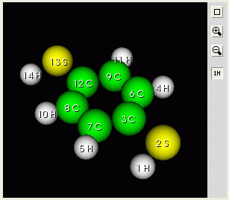
Molecules
Include atoms/molecules
<structure id=“mol”>
<current>
<components>
<molecule>
<about><emblems>on</emblems></about>
<formula>pdt</formula>
<atom id="0">
<symbol>H</symbol>
<xyz>-1.24935 -3.41562 0.0</xyz>
</atom>
<atom id="1">
<symbol>S</symbol>
<xyz>0.08092 -3.19426 0.0</xyz>
</atom>
…
</molecule>
</components>
</current>
</structure>
Turns atom labels
on by default

Slide 3
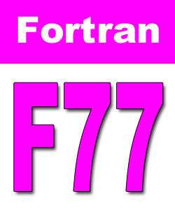
Molecules
Include atoms/molecules
<structure id=“mol”>
<current>
<components>
<molecule>
<pdb>ATOM 1 C 0.000 0.000 0.000
ATOM 2 C 1 0.000 0.000
ATOM 3 C 0 1.000 0.000
ATOM 4 C 0 0.000 1.000
</pdb>
</molecule>
</components>
</current>
</structure>
Generate within your program like this:
call rp_lib_put_file(io,
+ “output.(mol).current.components.molecule.pdb”,
+ “data.pdb”, 1, 0)
0 = overwrite (not append)
1 = compress data

Slide 4
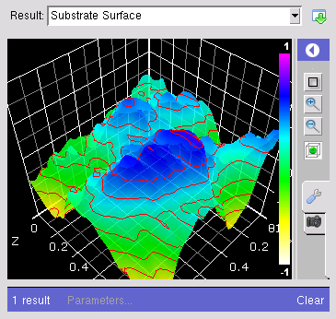
Data on a 2D rectangular grid
Generate surface plots and contour plots
x
y
z values at grid points
<field> = values
<mesh> = 2D or 3D mesh
Two separate objects, so you can use the same mesh with many fields

Slide 5

Mesh: uniform rectangular mesh
Should look like this in the run.xml file:
<output>
<mesh id="mygrid">
<dim>2</dim> <units>um</units>
<grid>
<xaxis>
<min>0.0</min>
<max>1.0</max>
<numpoints>50</numpoints>
</xaxis>
<yaxis>
<min>0.0</min>
<max>7.2</max>
<numpoints>100</numpoints>
</yaxis>
</grid>
</mesh>
…
Set values within your program like this:
io.put(‘output.mesh(mygrid).grid.xaxis.max', '1.0', append=0)
io.put(‘output.mesh(mygrid).grid.xaxis.numpoints', '50', append=0)
io.put(‘output.mesh(mygrid).grid.yaxis.min’, ‘1.5’, append=0)
io.put(‘output.mesh(mygrid).grid.yaxis.max’, ‘8.5’, append=0)

Slide 6

Field
Add field object to the run.xml file:
<output>
<mesh id="mygrid">
…as shown on previous page…
</mesh>
<field id="z">
<about>
<label>Substrate Surface</label>
</about>
<component>
<mesh>output.mesh(mygrid)</mesh>
<values>1.4358794e-01 1.1341028e-01 …
1.0426426e-01 1.1974895e-01 1.4802129e-01 …
1.5492613e-01 1.6212342e-01 1.8821293e-01 …
</values>
</component>
</field>
Y-index varies fastest
v(1,1) v(1,2) v(1,3) ...
v(2,1) v(2,2) v(2,3) ...
v(3,1) v(3,2) v(3,3) …
Generate within your program like this:
vals = reshape(z', npts*npts, 1);
str = sprintf('%12g\n', vals);
rpLibPutString(io,'output.field(z).component.values', str,0);

Slide 7
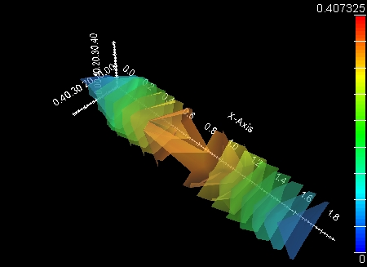
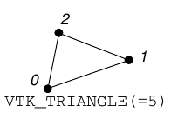
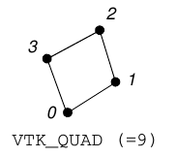
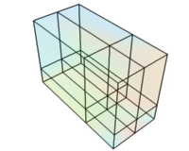
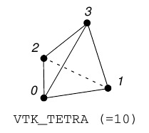
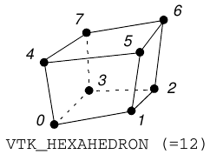
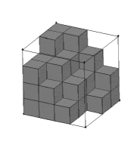
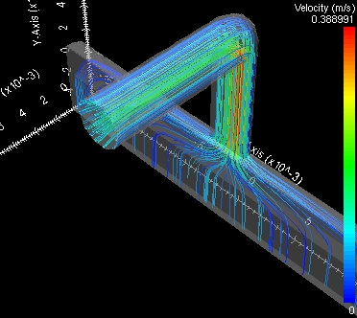
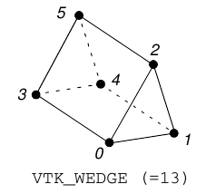
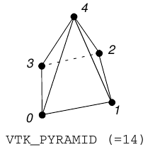
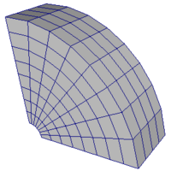
Many more options
fields
meshes
Isosurfaces
Streamlines
http://nanohub.org/infrastructure/rappture/wiki/rp_xml_ele_mesh
http://nanohub.org/infrastructure/rappture/wiki/rp_xml_ele_field

Slide 8
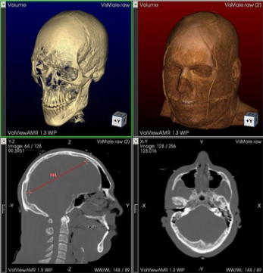
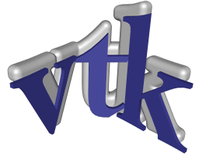
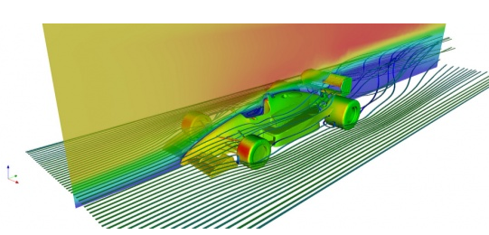
Vtk interface
Add field object to the run.xml file:
<output>
<field id=“complex">
<about>
<label>Wavefunction</label>
</about>
<component>
<vtk># vtk DataFile Version 3.0
Mesh-grid-irregular (Substrate Surface)
ASCII
DATASET RECTILINEAR_GRID
DIMENSIONS 50 50 1
X_COORDINATES 50 double
0.0 0.0204082 0.0408163 0.0612245 ...
</vtk>
</component>
</field>
Generate within your program like this:
rpLibPutFile(io,'output.field(complex).component.vtk',
’file.vtk', 1, 0);
0 = overwrite (not append)
1 = compress text

Slide 9
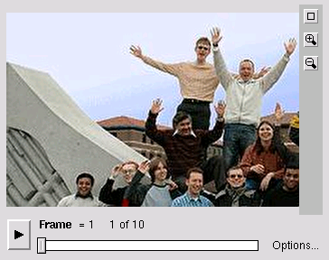
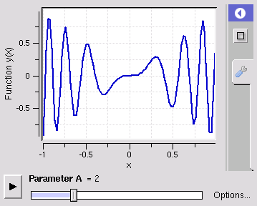
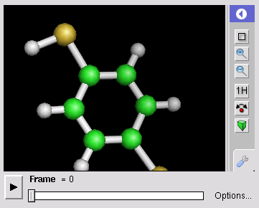
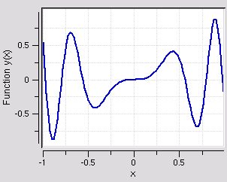
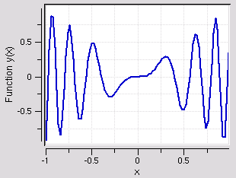
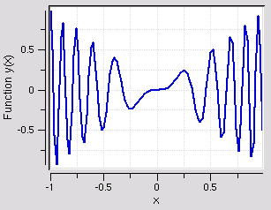
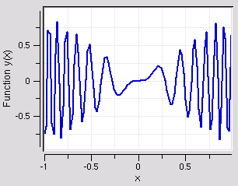
Sequences
Time series of values -- like a movie
Sequence of images
Sequence of curves
Sequence of molecules
index
A = 1
A = 2
A = 3
A = 4

Slide 10
Sequence of Curves
generate this:
<output>
<sequence id="outs">
<about>
<label>Sequence of Plots</label>
</about>
<index>
<label>Parameter A</label>
</index>
<element id="1">
<index>1</index>
<curve>…</curve>
</element>
<element id=“2">
<index>2</index>
<curve>…</curve>
</element>
…
</sequence>
Usual curve object stuff,
but inside the element
along with the index

